Slide 1
Project Pitch:
Interactive AI Image Creation Platform
Supervisor: Dr Lingqiao Liu
Group 4-K3
Notes:
Hello, we are group 4-K2. Our project is Interactive AI Image Creation Platform. We are here today to present about our project pitch.

Slide 2
Content
Section | Presented by
Industry overview | Yuqing Chen
Limitations of existing system | Yuqing Chen
Our project solution | Amber (Ngoc Anh Dao)
Analysis of our solution | Harry (Hoang Son Le)
Overview of the project plan & Conclusion | Harry (Hoang Son Le)
Notes:
Our presentation for today is organized as follows:
I am yuqing and I am going to present the industry overview and the analysis of limitations of existing systems.
And then amber will follow by our project solution
Finally Harry will talk about the analysis of our solution and the overview of the project plan

Slide 3
Content
Section | Presented by
Industry overview | Yuqing Chen
Limitations of existing systems | Yuqing Chen
Our project solution | Amber (Ngoc Anh Dao)
Analysis of our solution | Harry (Hoang Son Le)
Overview of the project plan & Conclusion | Harry (Hoang Son Le)
Notes:
Now I am going to talk about the industry overview

Slide 4
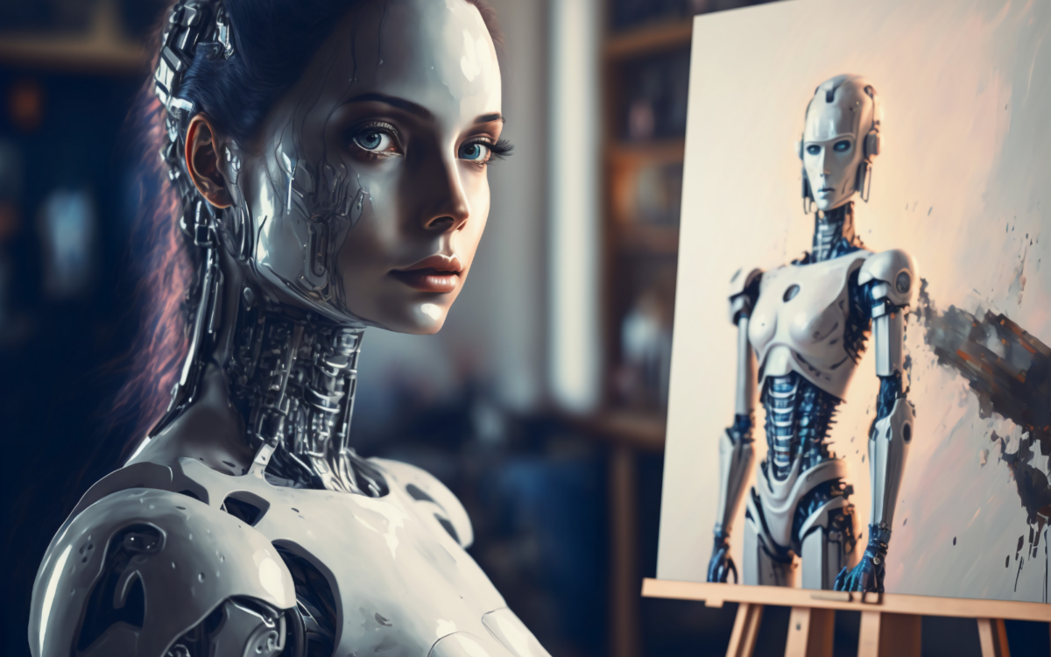
AI Image Generation Industry Overview
An AI image generator is a technology powered by Artificial Intelligence (AI) that can produce images, artworks, or visual content without direct human intervention.
Notes:
An AI image generator is a technology powered by Artificial Intelligence (AI) that can produce images, artworks, or visual content without direct human intervention.

Slide 5
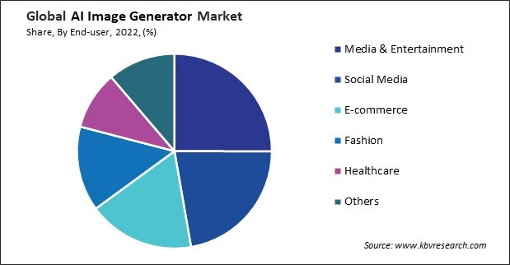
AI Image Generation Industry Overview
AI Image Generator
Global Market Value
$260M
(2022)
$900M
(2030)
Notes:
The AI image generator market has significant growth in recent years.
According to the Market Research Report, the AI image generator market was valued at over two hundred million US dollars in revenue in twenty twenty two and is anticipated to reach over nine hundred million US dollars by twenty thirty.
(click)
On the basis of end-user, the market is divided into media & entertainment, healthcare, fashion, social media, e-commerce, and others.

Slide 6
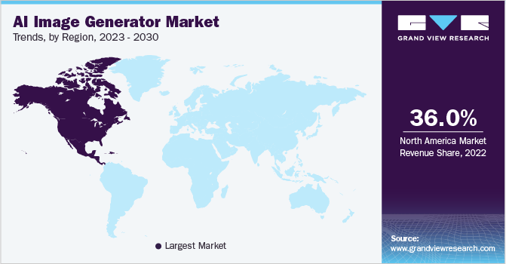
Market share by countries
Notes:
But North America still holds the major market share of ai image generator. According to Market Analysis Report, in twenty twenty two, North America has a market share of thirty six percent.

Slide 7




Major players in the field
Currently, the main image generator tools on the market come from: Midjourney, OpenAI
Midjourney
OpenAI
Dream Studio
Dream by WOMBO
However, in Australia, the market of AI generator is still relatively small.
Notes:
Currently, the main image generator tools on the market come from: (click) Midjourney, (click) Open AI, (click) Dream studio, (click)
Dream by WOMBO.
(click)
However, in australia , the market of AI generator is still relatively small. As we only have two famous companies - canva and leonardo.AI.

Slide 8
Content
Section | Presented by
Industry overview | Yuqing Chen
Limitations of existing systems | Yuqing Chen
Our project solution | Amber (Ngoc Anh Dao)
Analysis of our solution | Harry (Hoang Son Le)
Overview of the project plan & Conclusion | Harry (Hoang Son Le)
Notes:
In terms of the current solutions, most of the AI image generators can produce high quality images and implement text-to-image features.
But there are several limitations.

Slide 9
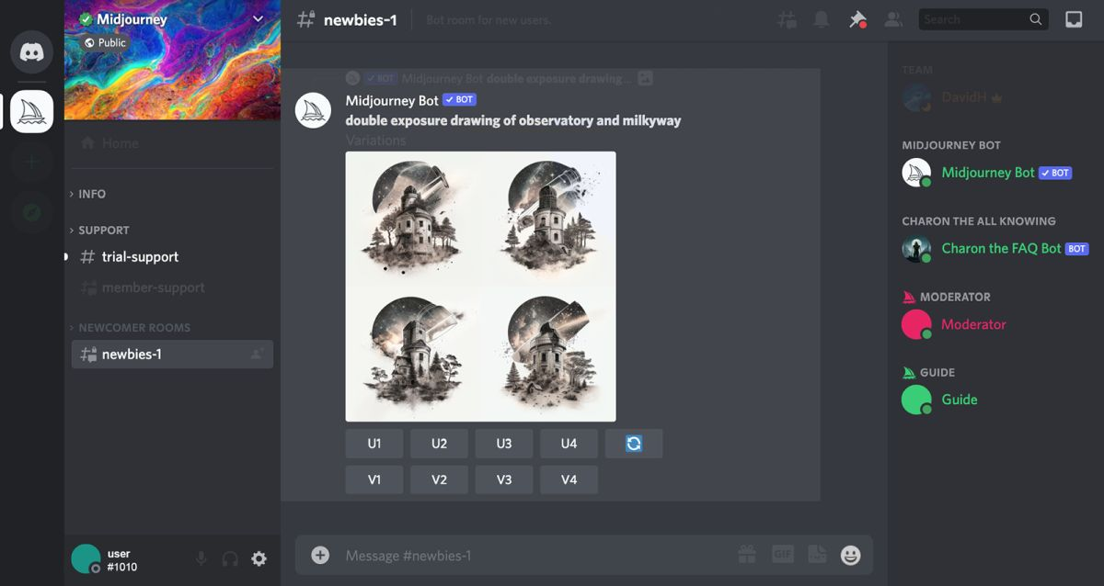

Limitations of Existing Systems
Unable to use multiple prompts
Difficult iteration
Notes:
For example, this is the midjourney’s user interface. (click) user are unable to use multiple prompts, which makes users may not be able to express their requirements well. It would be better if users could upload other files like sketches or reference images.
Also,(click) iteration becomes difficult because each image is created from scratch in each iteration and the previous output is not taken into account.

Slide 10
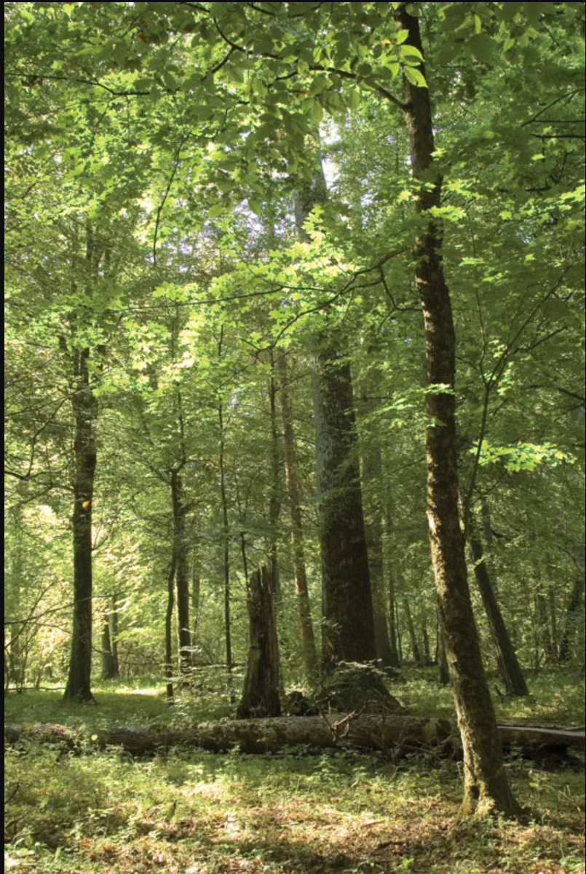
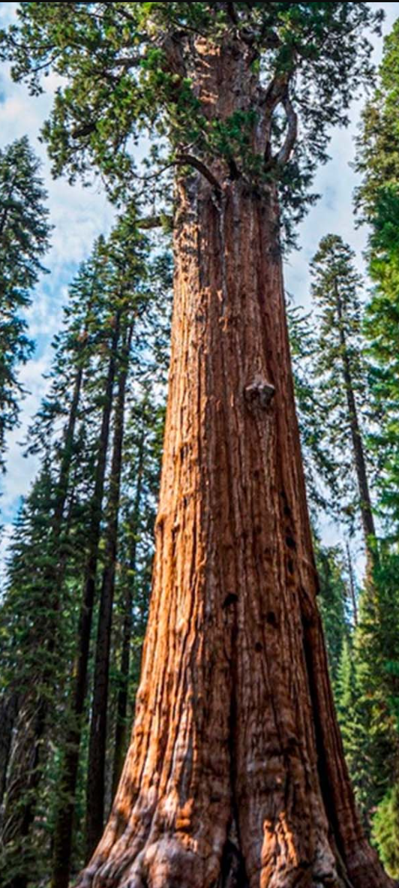
Limitations of Existing Systems
Lack of controllability - difficult to represent abstractions
Notes:
Moreover, It’s difficult to represent abstractions. for example if users are requesting a redraw of the tree in the middle of the page. It’s difficult to pin point the tree but easy with a bounding box to redraw the tree in the first image using the tree in the second image.
Now I am going to pass on the time to Amber.

Slide 11
Content
Section | Presented by
Industry overview | Yuqing Chen
Limitations of existing systems | Yuqing Chen
Our project solution | Amber (Ngoc Anh Dao)
Analysis of our solution | Harry (Hoang Son Le)
Overview of the project plan & Conclusion | Harry (Hoang Son Le)

Slide 12
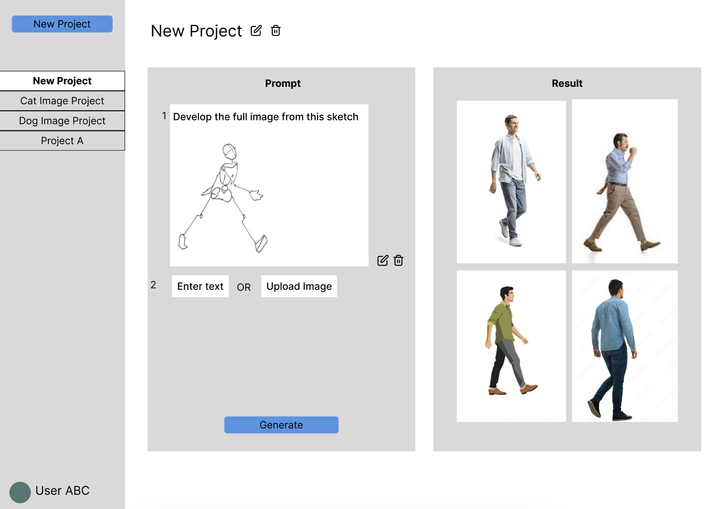
Our Project - Interactive AI Image Generator

Slide 13
Existing Solutions
Are the images good enough?
User enters text OR image
System generates image(s)
Yes
Done, download / save image(s)
Edit prompt
No
Notes:
For most of the current existing solutions, the user flow is like this.
- the user enters a text OR and image as the prompt, then system will generate the images
- if they are not happy with the result, user can edit the prompt
- they are happy, they can save and download the images

Slide 14
Our Solution
Interactive AI Image Generator
Are the images good enough?
User enters
System generates image(s)
Yes
Done, download / save image(s)
Text
and/or
Text & Image
Edit prompts
No
as prompts
Key values compared to existing solutions:
1) Taking multiple prompts
2) Taking images as prompts which can be
Reference images
Sketches of the final image
Part of a previously generated image
Notes:
Our project will be developed to address the limitations of existing solutions.
We offer a very interactive interface where user can enters various types of input
They can enter just text, or add an image, accompanied by explanation texts.
This allows them to express their ideas better, ensuring a result that matches better to their requirements.
(click)
The key values that we bring to the users are:
1) our platform takes in not one but variable number of prompts, allowing users to easily mix and match and separate different requirements for their images
2) by taking in a combination of text and images, our website allow users do to things like
including a reference image, a sketch of the final image, or select a part of a previously generated image that they like or do not like
I will elaborate more in the following slides

Slide 15
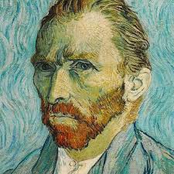
Taking Images and Texts as Input
500 × 500
Reference Image
eg. "Convert this painting into a photo"
Notes:
an example of using reference image is like this, user can upload an image as a starting point and tells the machine what they want to do with it

Slide 16
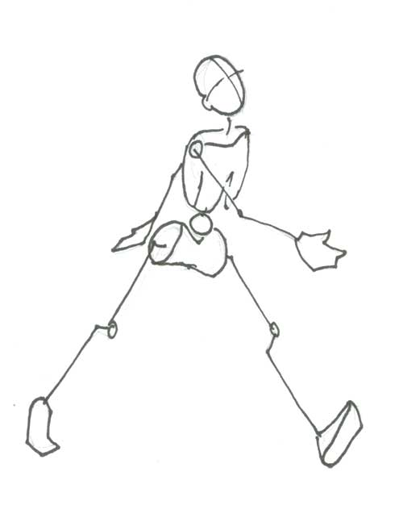
Taking Images and Texts as Input
Sketches
eg. "Complete sketch to make an image of a walking man"
Notes:
user can even upload a sketch of their original ideas, and informs the machine to complete it

Slide 17
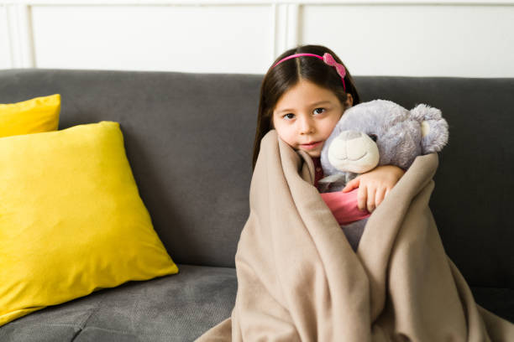
Taking Images and Texts as Input
Part of a previously generated image
eg. "Replace the teddy bear selected by a puppy"
User can combine multiple prompts, such as providing the image of the said puppy
Notes:
they can even select a part of a previously generated image and tell the machine what they want to change, for example, replacing this teddy bear with a puppy
by taking in multiple prompts, the user can even upload the image of the puppy that they want the machine to use

Slide 18




Supporting Features
They are features that already exist in current solutions - they are not key differentiators but still needed to bring our product on par with current solutions
Project organisation to separate different topics / creations
Hosted on cloud for easy access anywhere
User account creation and login
Flexible options to download and share files
Notes:
besides the main features above, we also plan to work on other supporting features
(click) firstly, we will allow the user to organise their creations into topics, allowing them to easily find and update the previous versions of images
(click) we will also host on a cloud so that users can access this anywhere
(click) if the time allows, we may also support user account creation and login
(click) as well as flexible options to download and share the projects and files

Slide 19
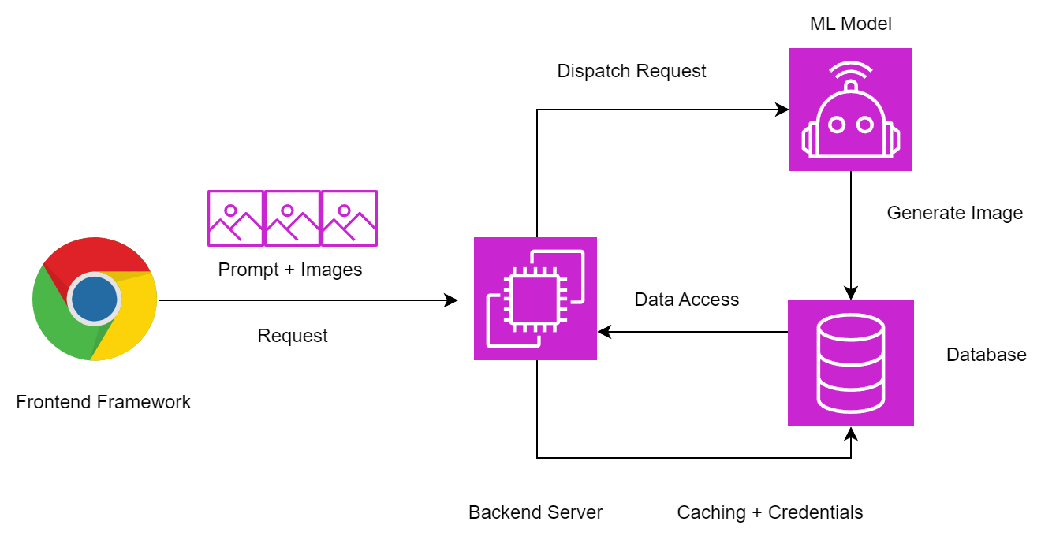
Proposed System Architecture
Notes:
This is our current proposed system architecture
Will not go into the details, basically we will develop the front end framework, as well as supporting database and data access engines.
The ML model is supplied by our supervisor, Dr Lingqiao Liu and his research group

Slide 20
Content
Section | Presented by
Industry overview | Yuqing Chen
Limitations of existing systems | Yuqing Chen
Our project solution | Amber (Ngoc Anh Dao)
Analysis of our solution | Harry (Hoang Son Le)
Overview of the project plan & Conclusion | Harry (Hoang Son Le)

Slide 21
Analysis of our solution
Incorporate features of existing solutions
Text to image generation
Chat log/conversation log
Add features based on current research capabilities
Image editing
Masked inpainting
Image to Image translation
Notes:
Image to Image translation - an input image guides the layout and the text guides the perceived semantic and appearance of the scene

Slide 22
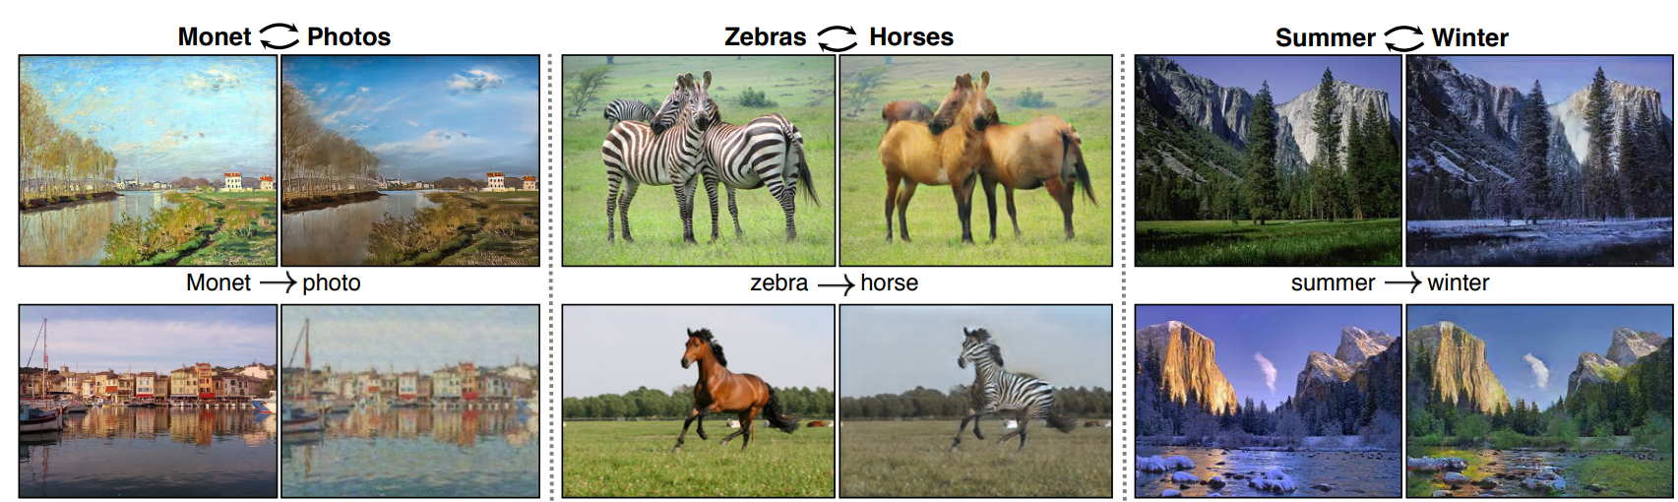
Image to Image Generation

Slide 23
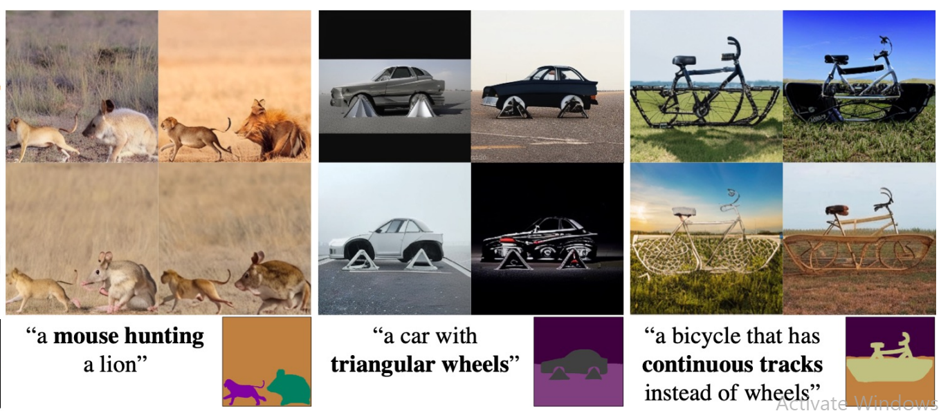
Masked guided generation

Slide 24
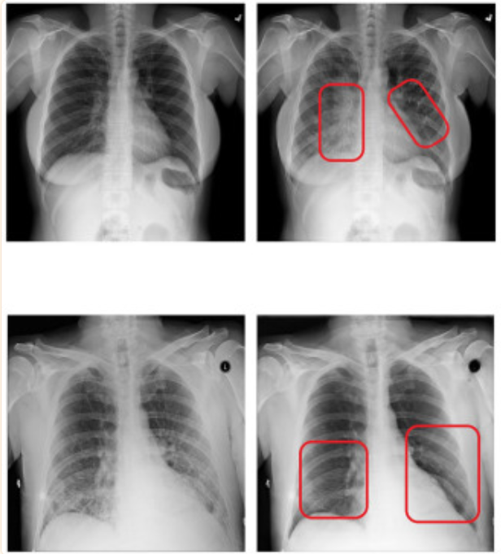
Possible applications - Medical
Counter-factual analysis:
Example:
“Generate a CT-Scan of
a person not afflicted with
pneumonia”

Slide 25
Content
Section | Presented by
Industry overview | Yuqing Chen
Limitations of existing systems | Yuqing Chen
Our project solution | Amber (Ngoc Anh Dao)
Analysis of our solution | Harry (Hoang Son Le)
Overview of the project plan & Conclusion | Harry (Hoang Son Le)

Slide 26
Overview of Project Plan
Milestone 1 | Finish FE UI design
 | Finish backend database system
 | Obtain pretrained image generation models
Milestone 2 | Implement text to image generation interface
 | Implement image editing interface + feature
Possible extension in the future | Login/credentials
 | Deployment
 | Scaling and Optimisation

Slide 27
Conclusion / Summary
Text to image generation platforms exist but
Lack controllability and flexibility
Do not support editing features
Provide an open-source text to image generation platform
Allow for image generation with better human-guided prior
Enable image editing capability

Slide 28
References
[1] AI Image Generator Market Size, Share & COVID-19 Impact Analysis, By Application (Personal and Enterprise), By End-user (Advertising, Healthcare, Gaming, Fashion, E-commerce, and Others), and Regional Forecast, 2023-2030, Fortune Business Insights, viewed March 2024, <https://www.fortunebusinessinsights.com/enquiry/request-sample-book/ai-image-generator-market-108604>
[2] AI Image Generator Market Size, Share & Trends Analysis Report By Component (Software, Services), By End-user (Media & Entertainment, Healthcare), By Region, And Segment Forecasts, 2023 - 2030, Great View Research, viewed March 2024, <https://www.grandviewresearch.com/industry-analysis/artificial-intelligence-ai-image-generator-market-report>

